Slide 1
Analyzing the Results of the db5 Edge-Deletion Experiment
Maggie ONeil and Lauren Kelly
February 9th, 2018
Dahlquist Lab Meeting

Slide 2
Each edge from db5 was systematically deleted and run through both GRNmap and Gephi
In some cases, when an edge was deleted, a node was also deleted to remove an isolated node
Results from GRNmap (parameter estimation, LSE:minLSE) and results from Gephi were compiled for comparison
Measures (LSE:minLSE, production rates, graph stats etc) were compared between the edge deletion networks and the intact db5 network

Slide 3
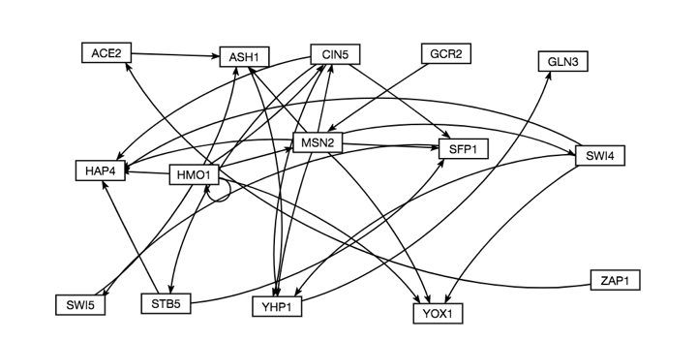

Slide 4
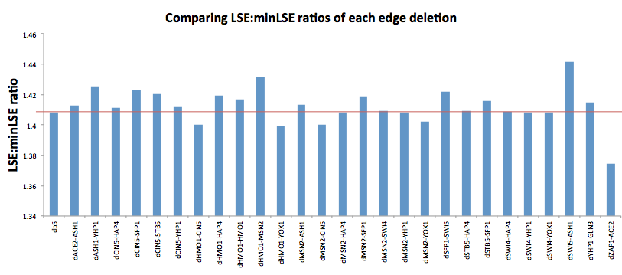
LSE:minLSE Ratios

Slide 5
Paired t-tests show variance of measure between db5 and the edge deletion networks
Notes:
Red = significant
Blue = no change

Slide 6
Overall findings
Closeness centrality has no significance in variance, and when HMO1-HMO1 was deleted there was no change
Eccentricity overall least impacted by edge deletions
Eigencentrality experienced the most significant changes as a result of the deletions
dHMO1-HMO1 overall does not appear to be a crucial part of the network

